Slide 1
ADF Pipeline 4
ADLS + Azure Blob Storage → ADF → Azure SQL Database

Slide 2
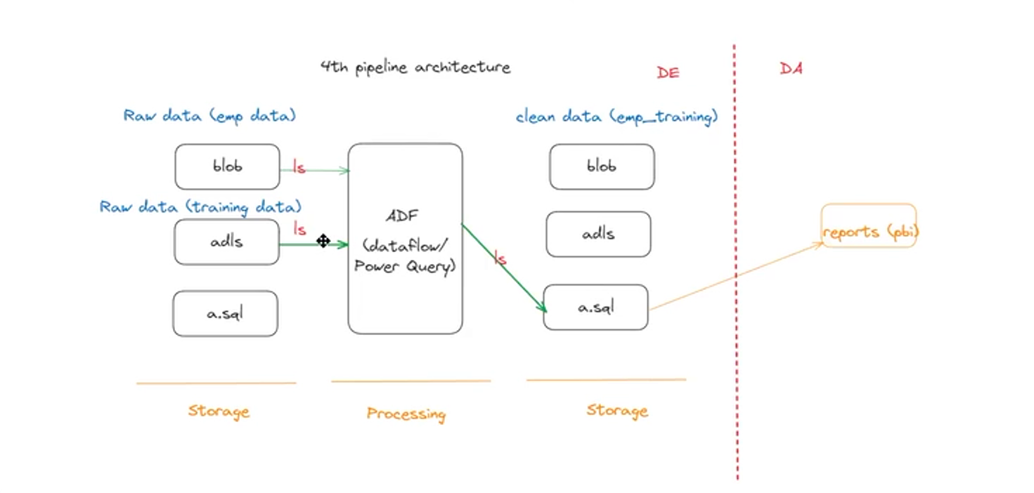

Slide 3
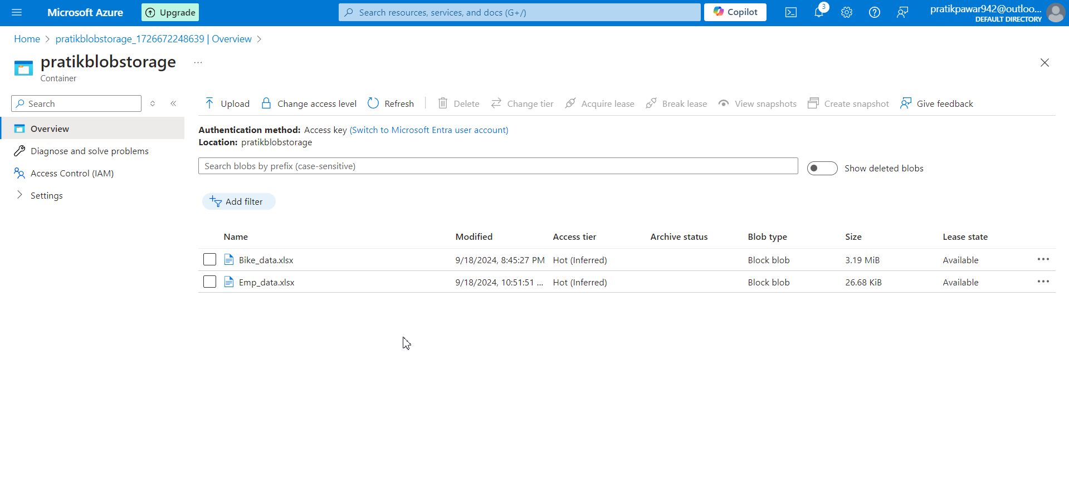
Upload data in Azure Blob storage

Slide 4
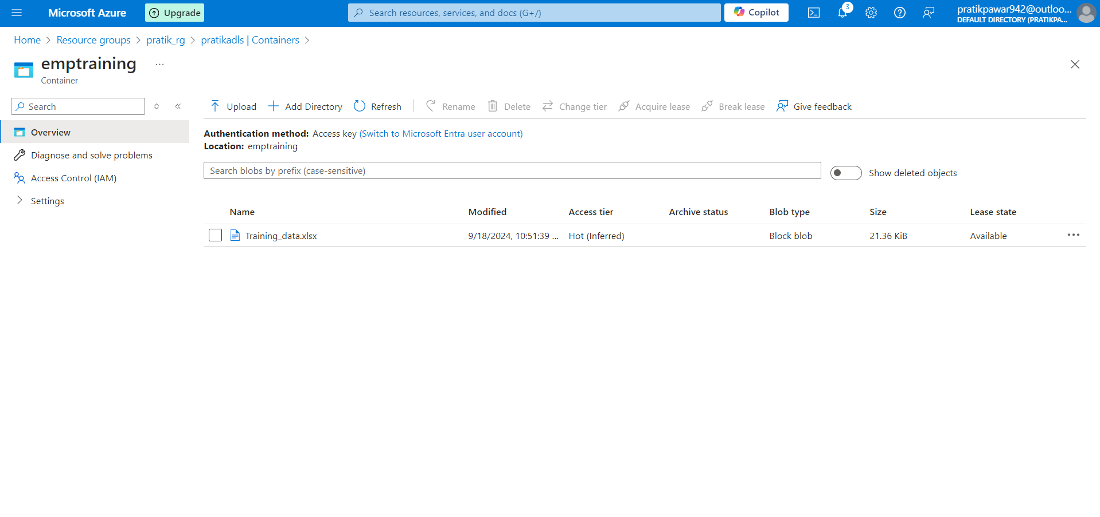
Upload Data in ADLS

Slide 5
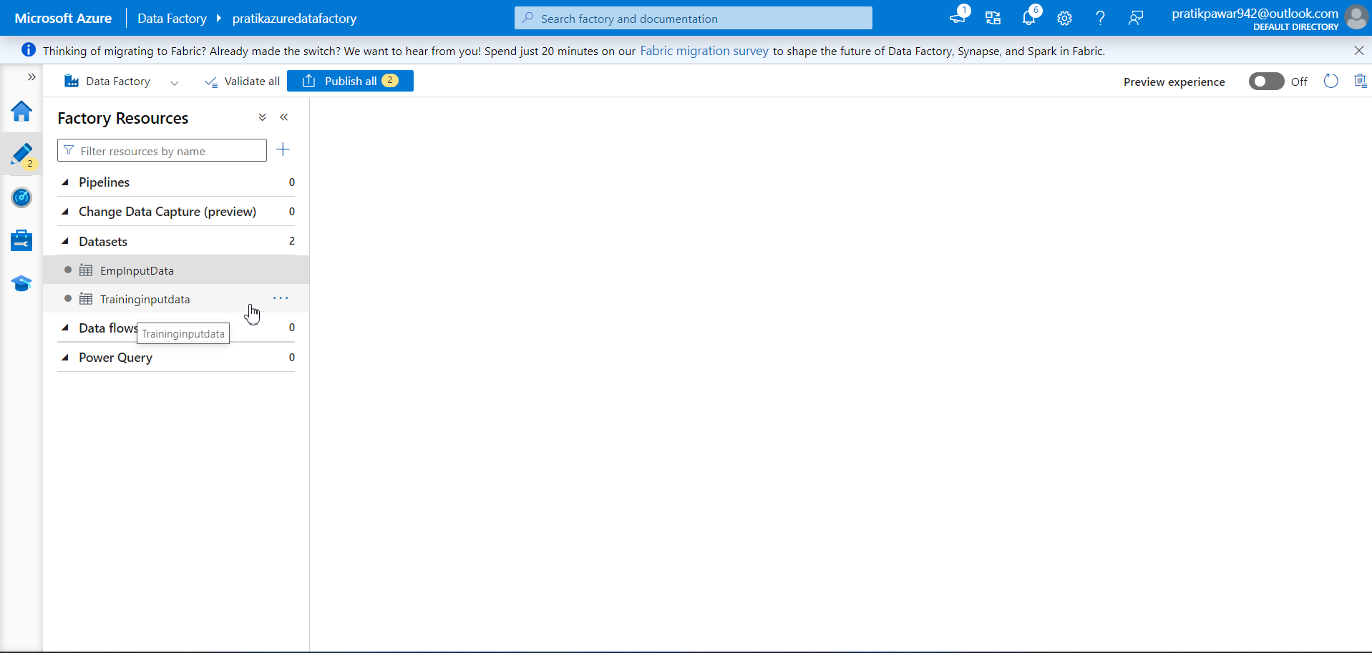
Linked both in ADF and get data in Datasets

Slide 6
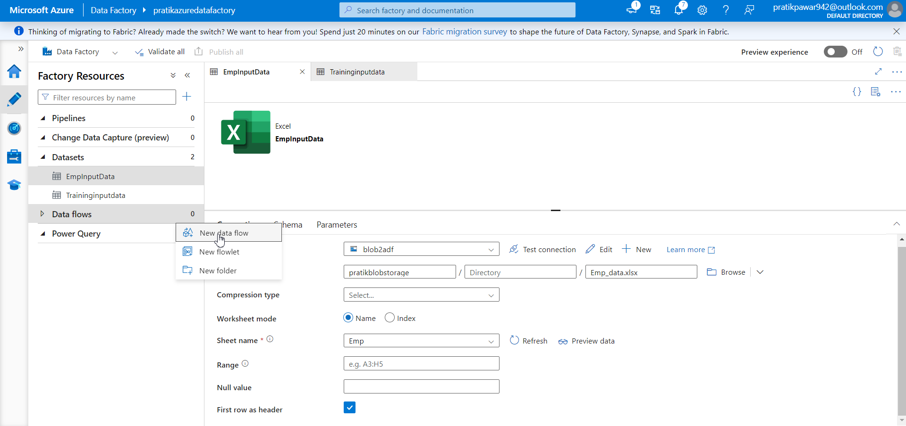
New data flow

Slide 7
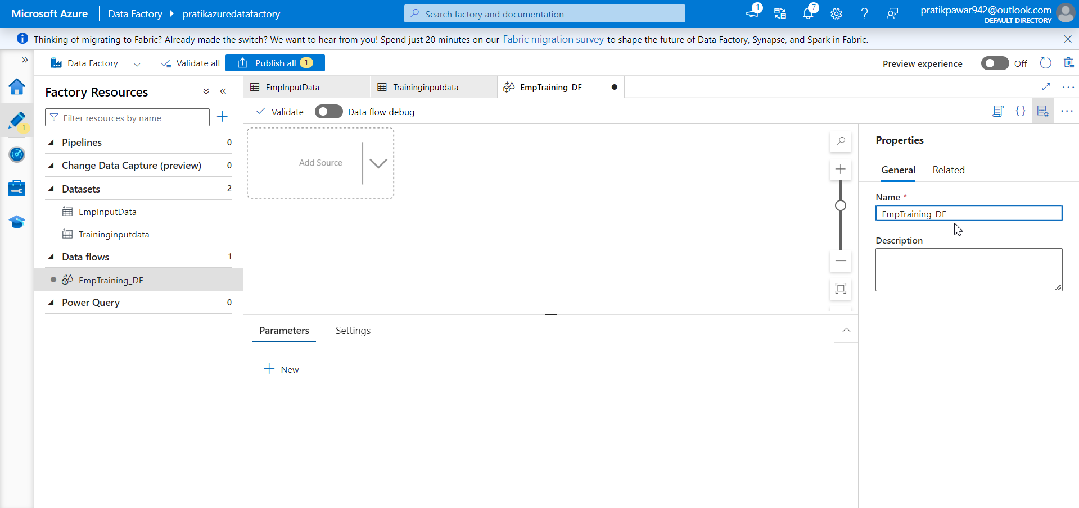
Rename to EmpTraining_DF

Slide 8
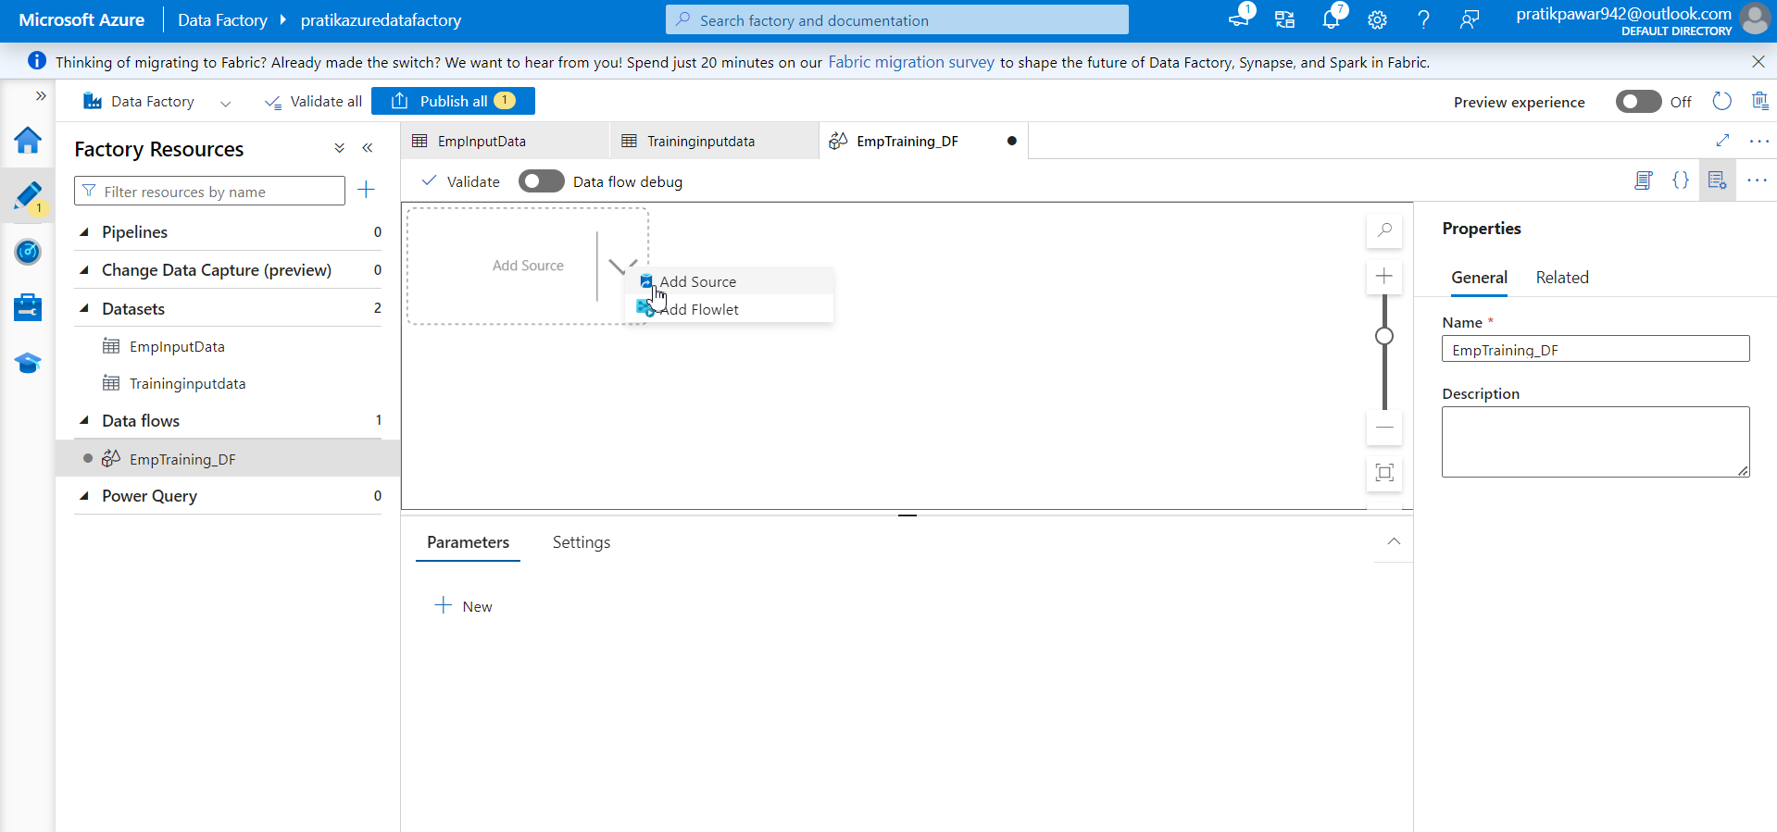
Go to Add source

Slide 9
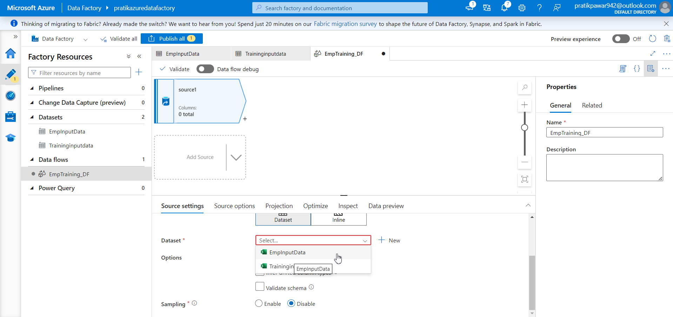
Select EmpInputdata in Source

Slide 10
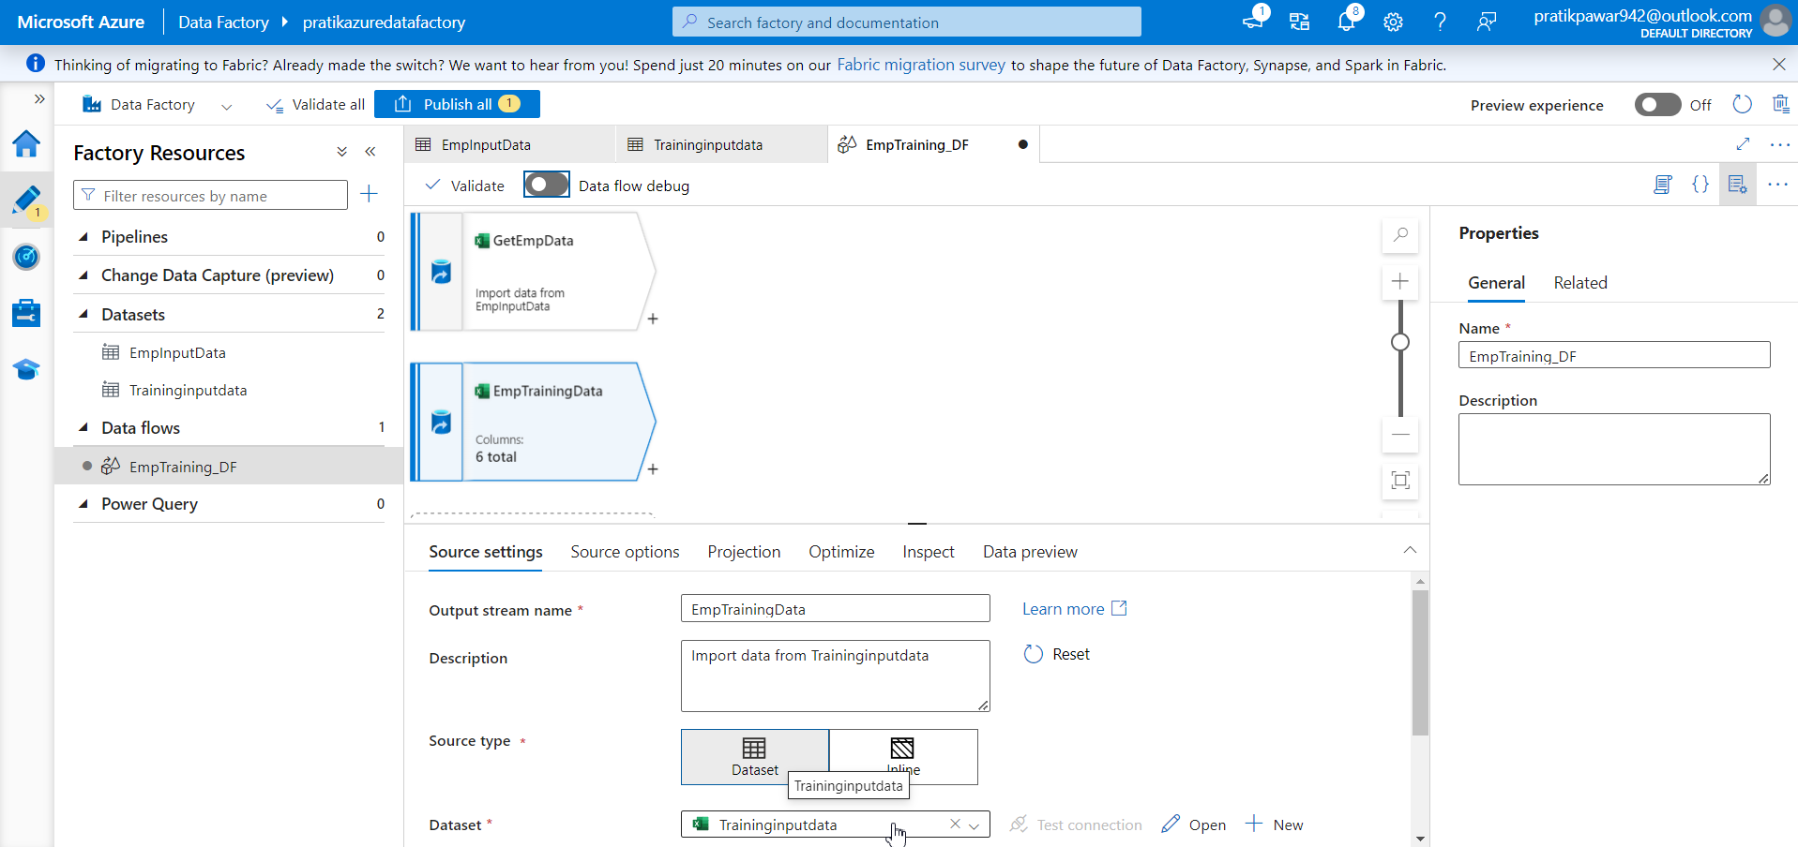
Similarly for EmpTrainingData

Slide 11
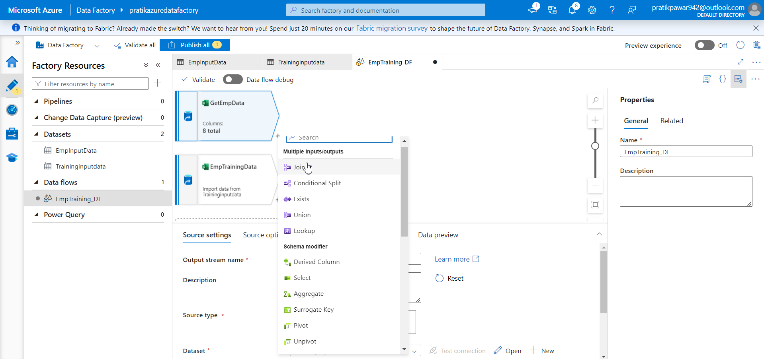
Select + then Joins

Slide 12
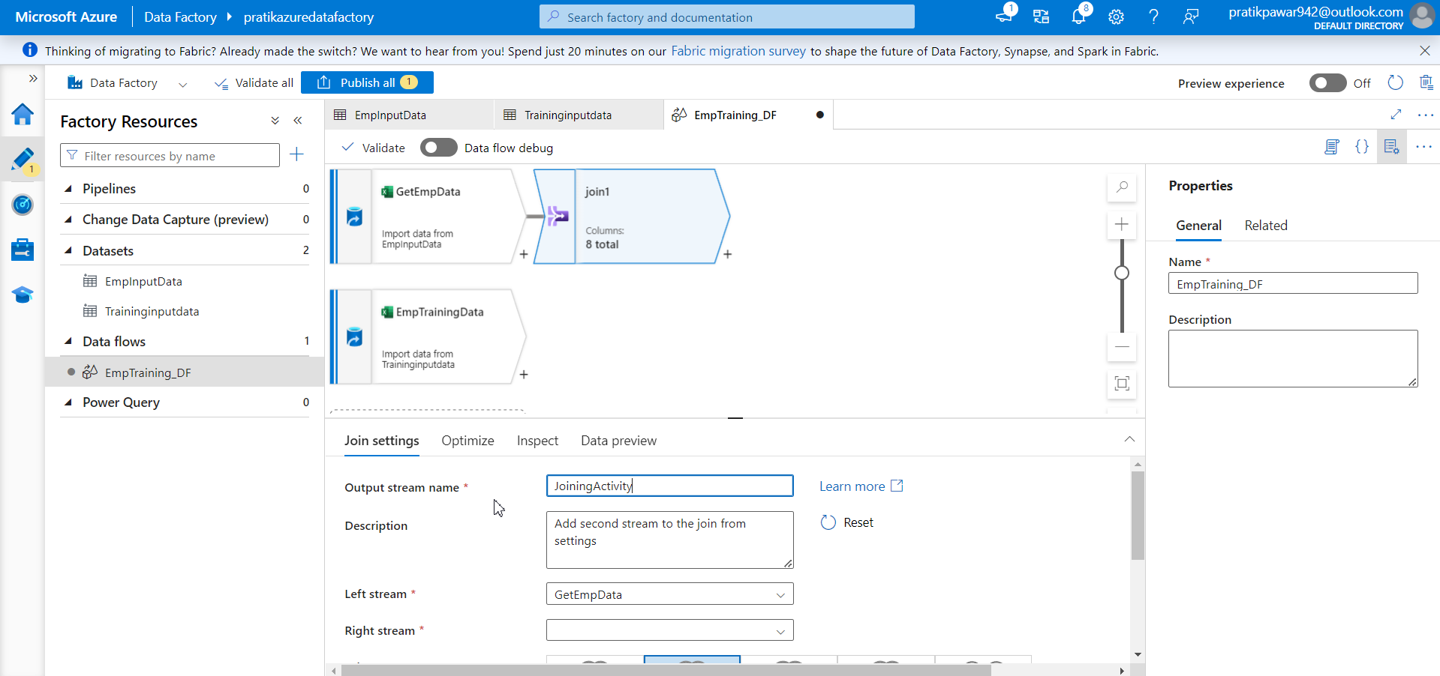
Give name

Slide 13
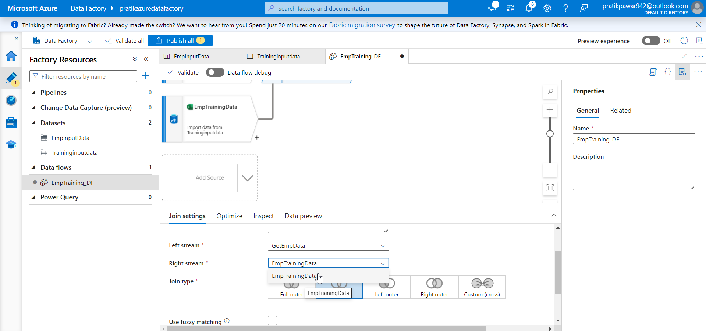
Select which two data we are going to join

Slide 14
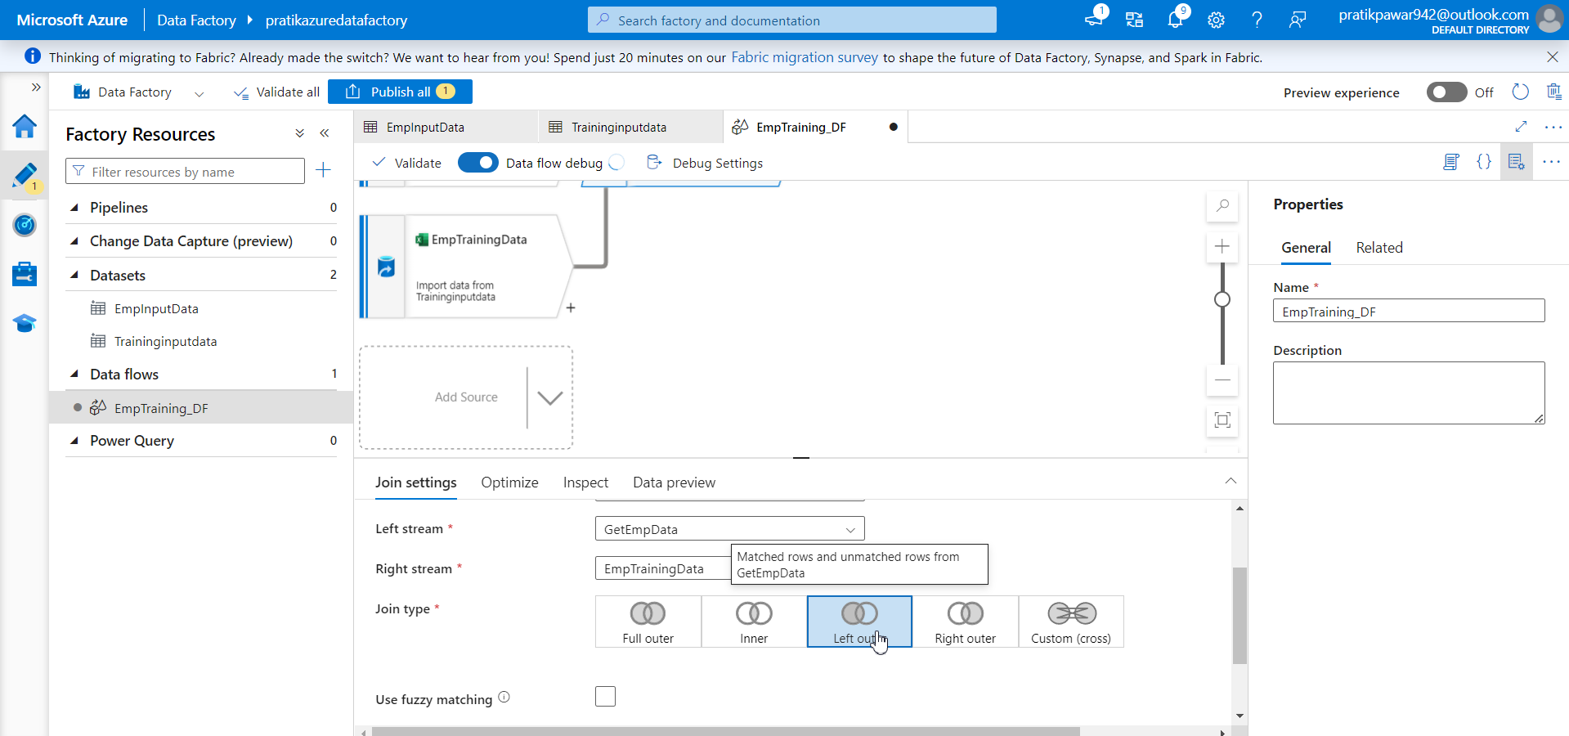
Give which join we want

Slide 15
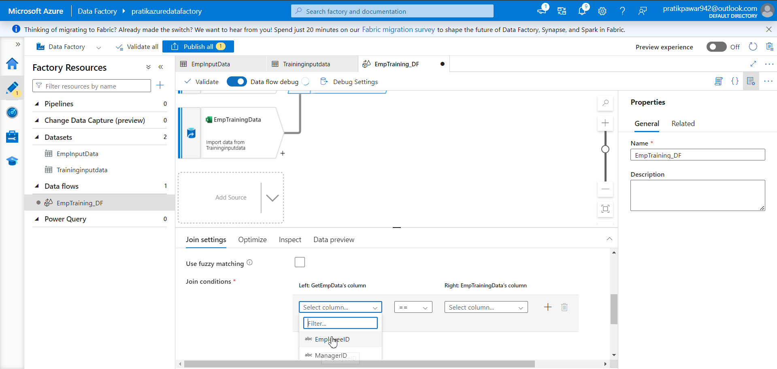
Select which two colmns are similar

Slide 16
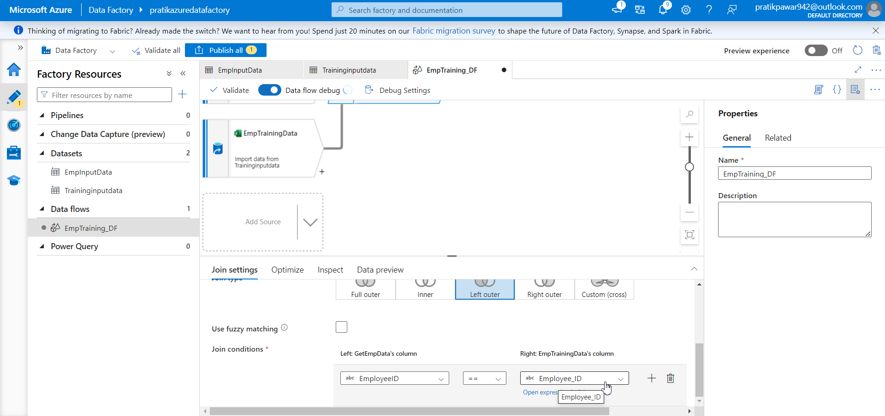
Employee_id with Employee_id

Slide 17
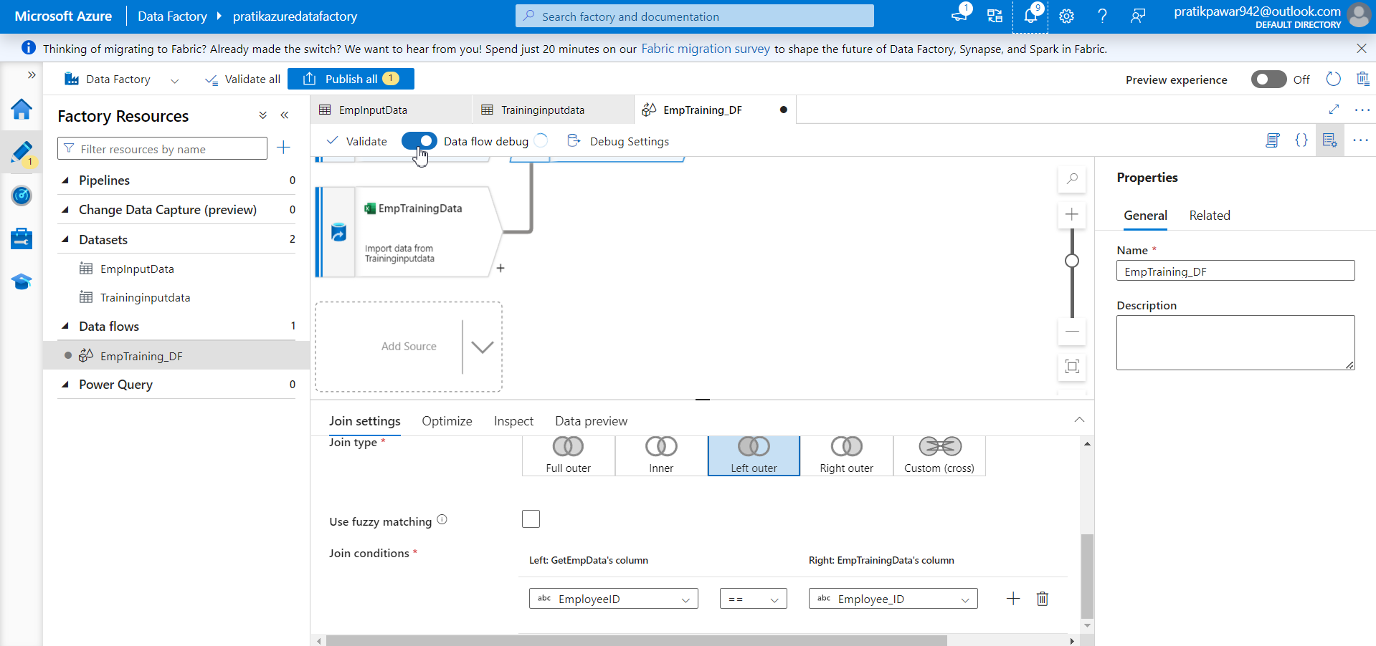
On the Debug mode to preview data

Slide 18
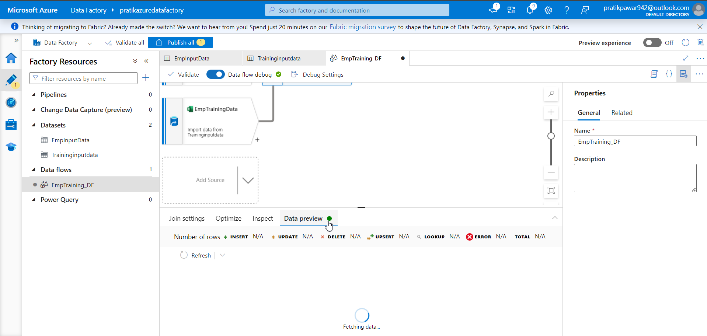
Go to data preview

Slide 19
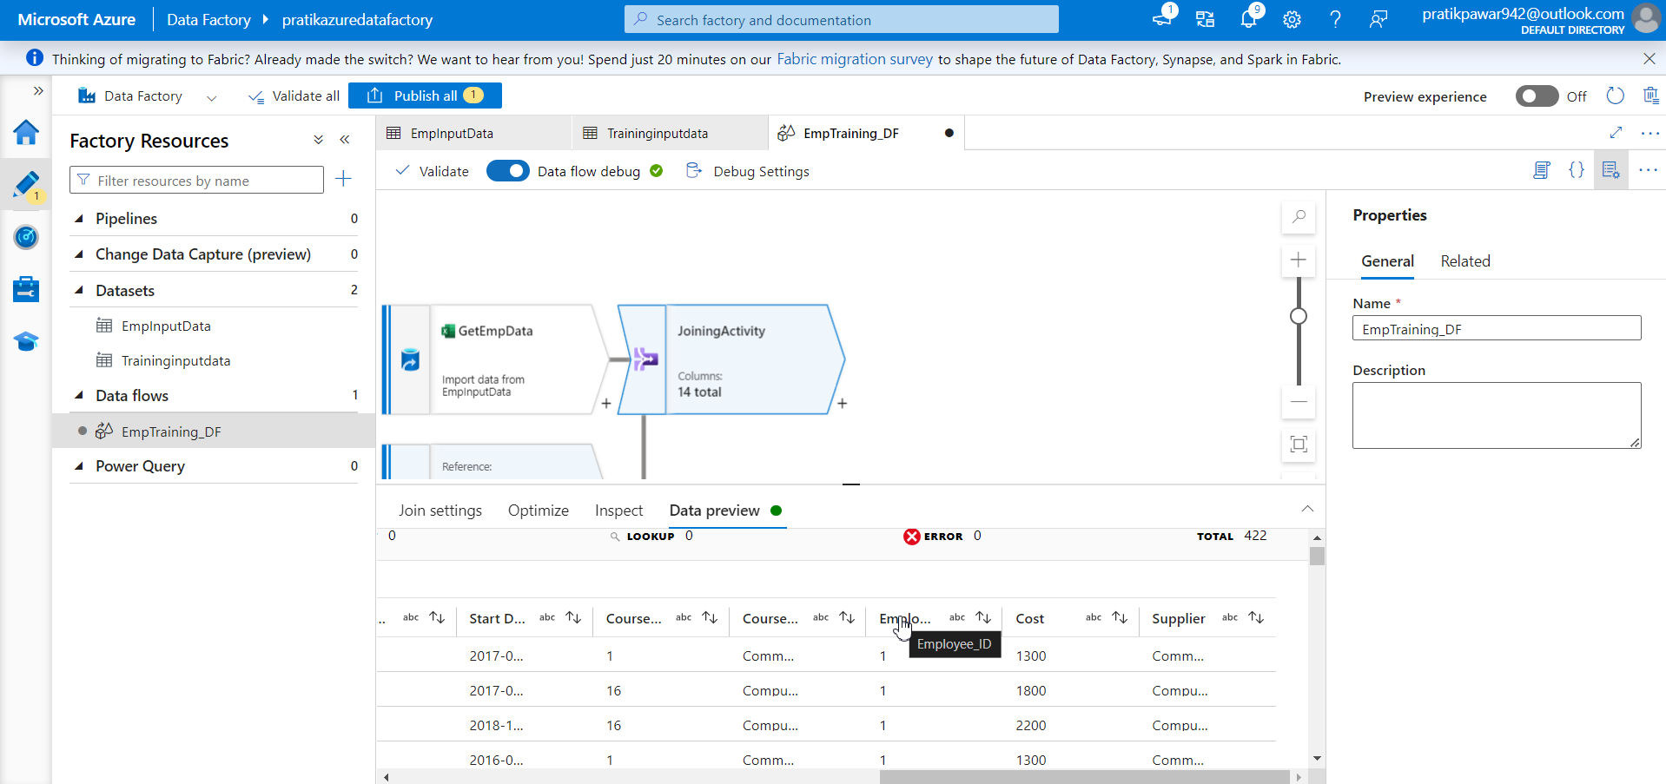
Here Employee_id column is double during the join as it is present in both the table

Slide 20
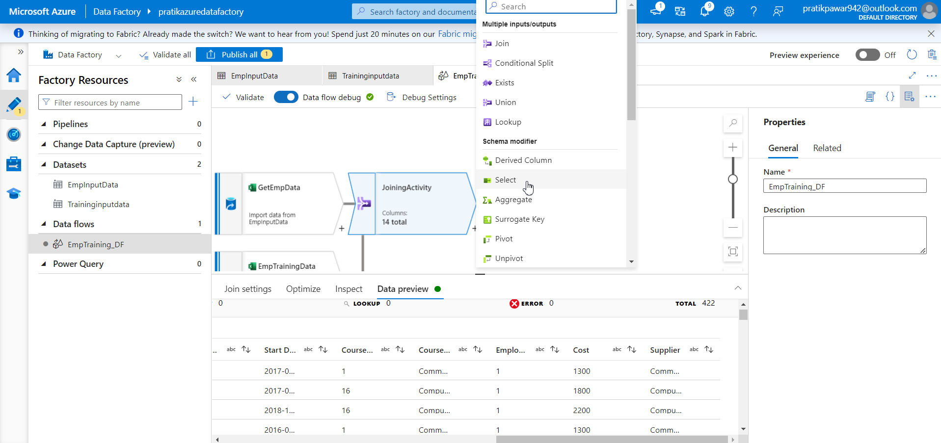
Go to select

Slide 21
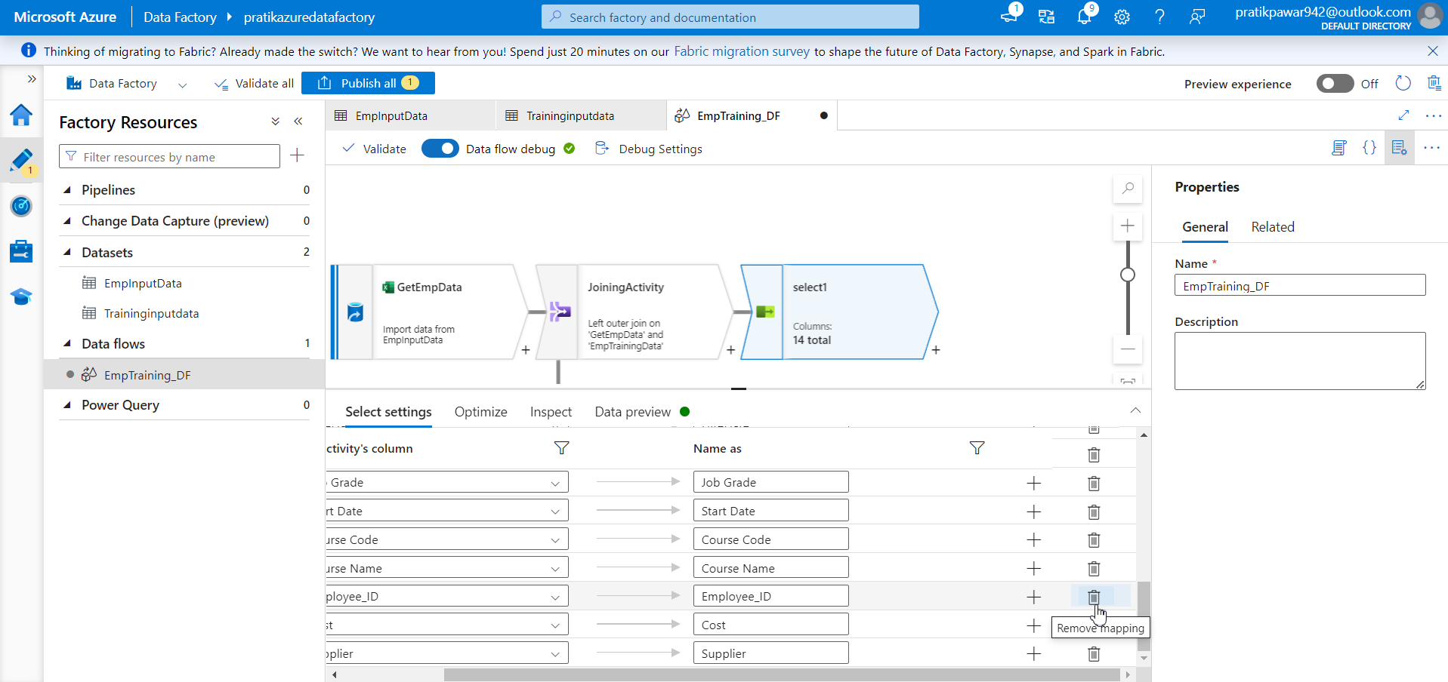
Delete Employee_id Column

Slide 22
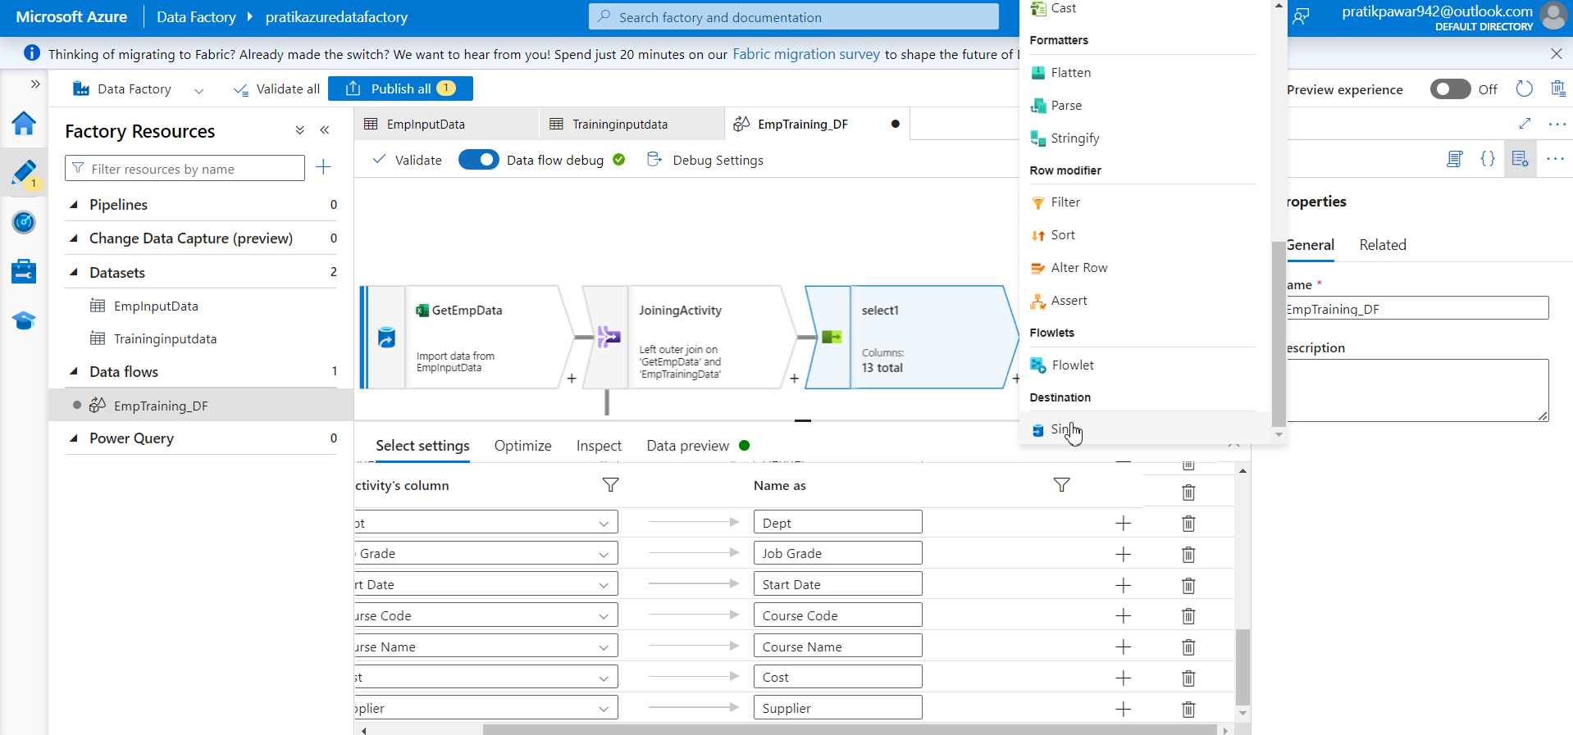
Finally Sink the data

Slide 23
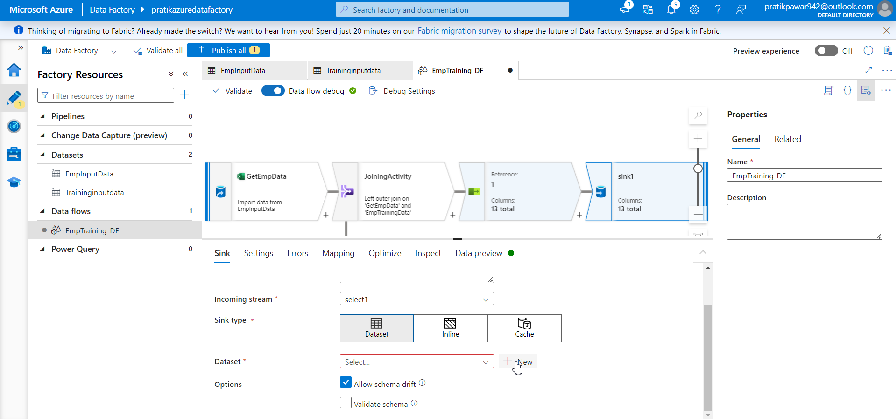
Create new dataset to sink data ie in SQL database

Slide 24
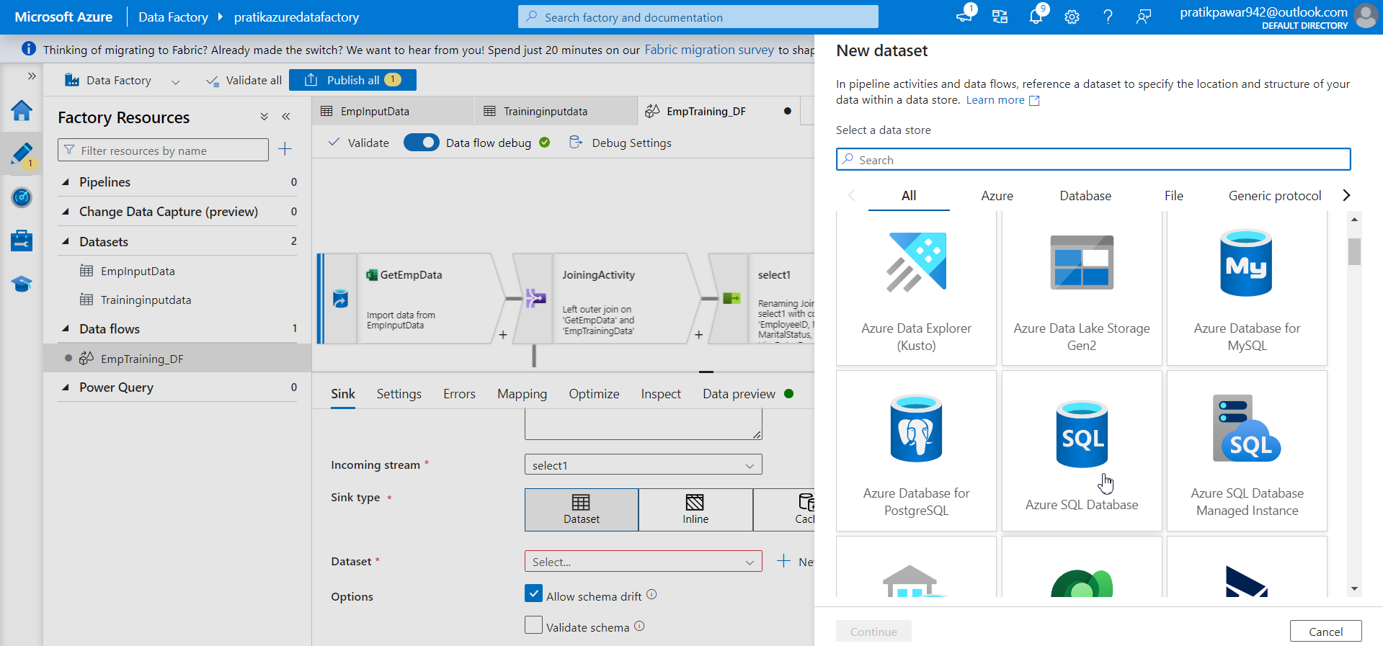
Azure Sql Database

Slide 25
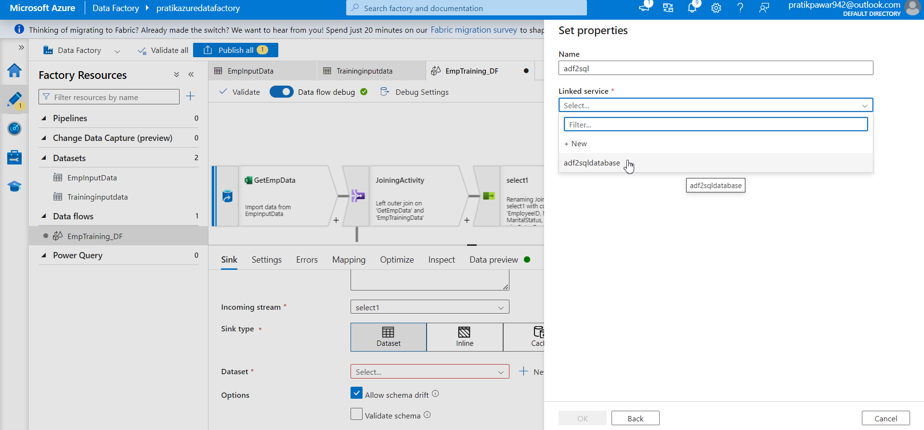
Select the linked database

Slide 26
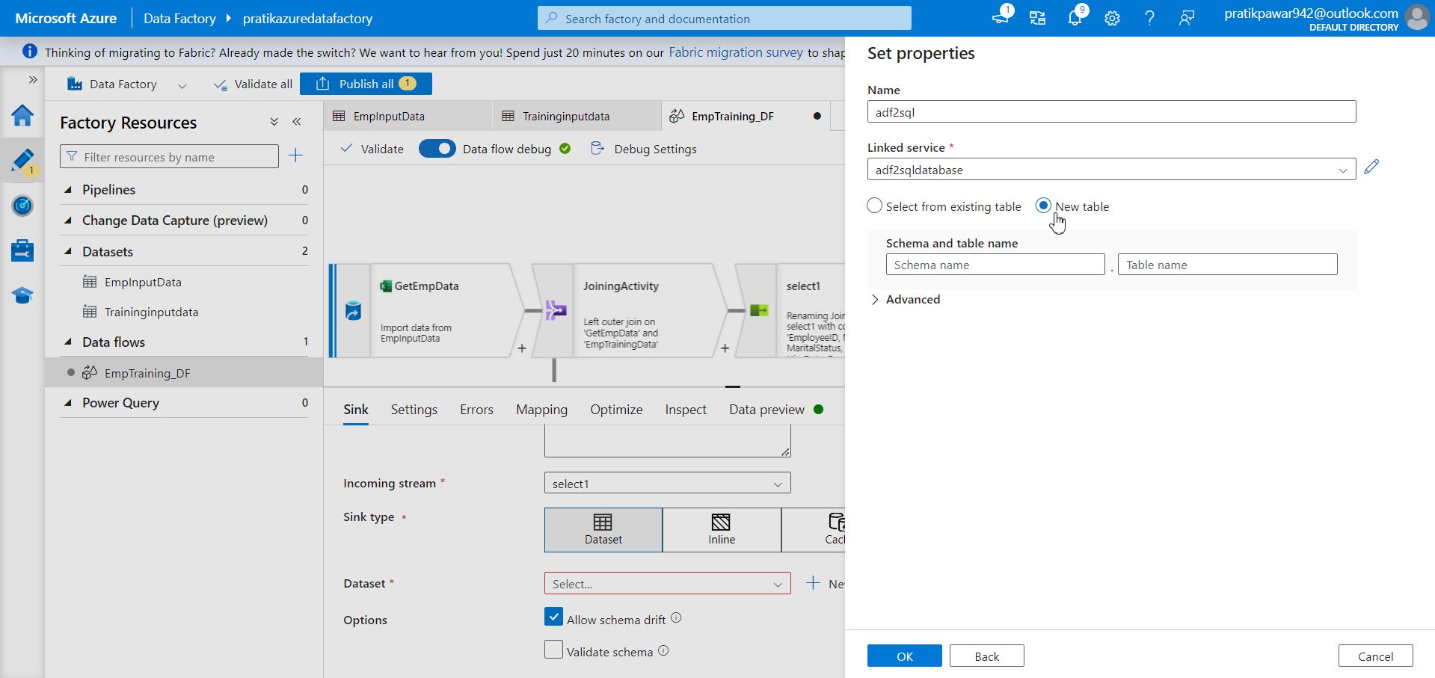
New table and write table name

Slide 27
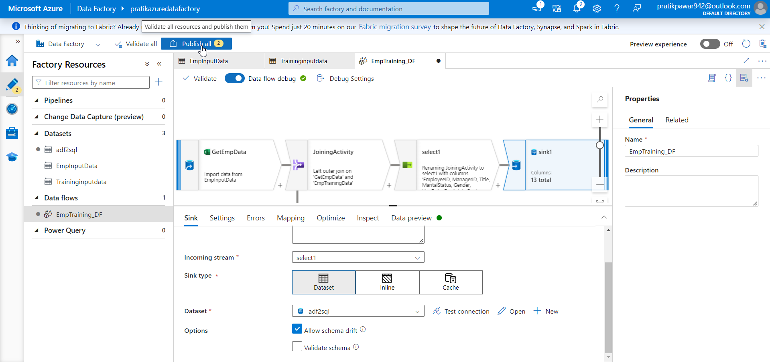
Publish all

Slide 28
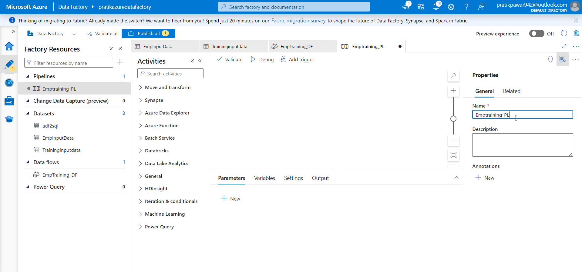
Create new pipeline and Name it

Slide 29
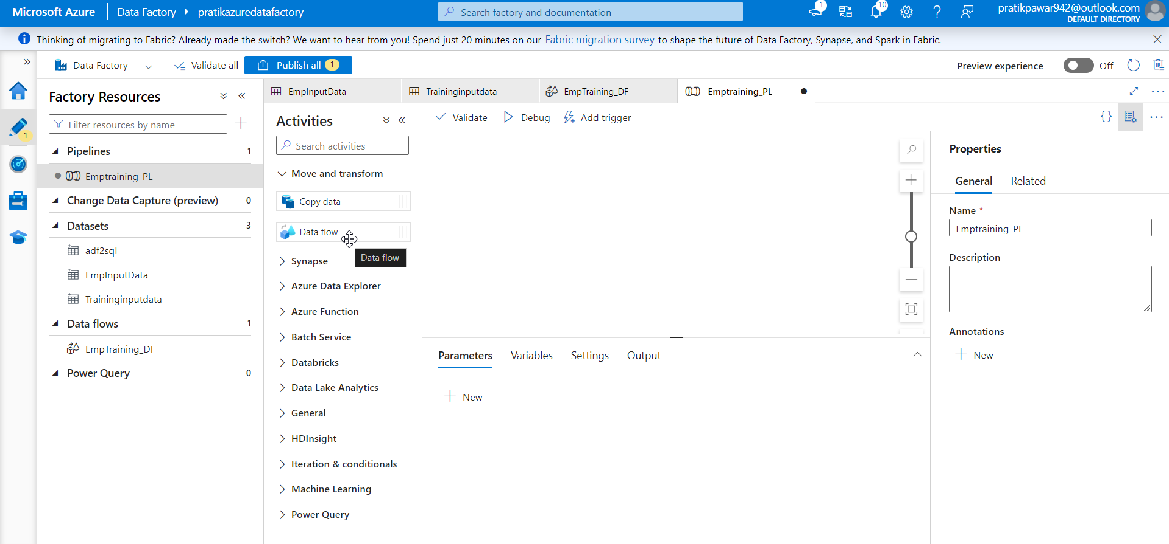
Data flow

Slide 30
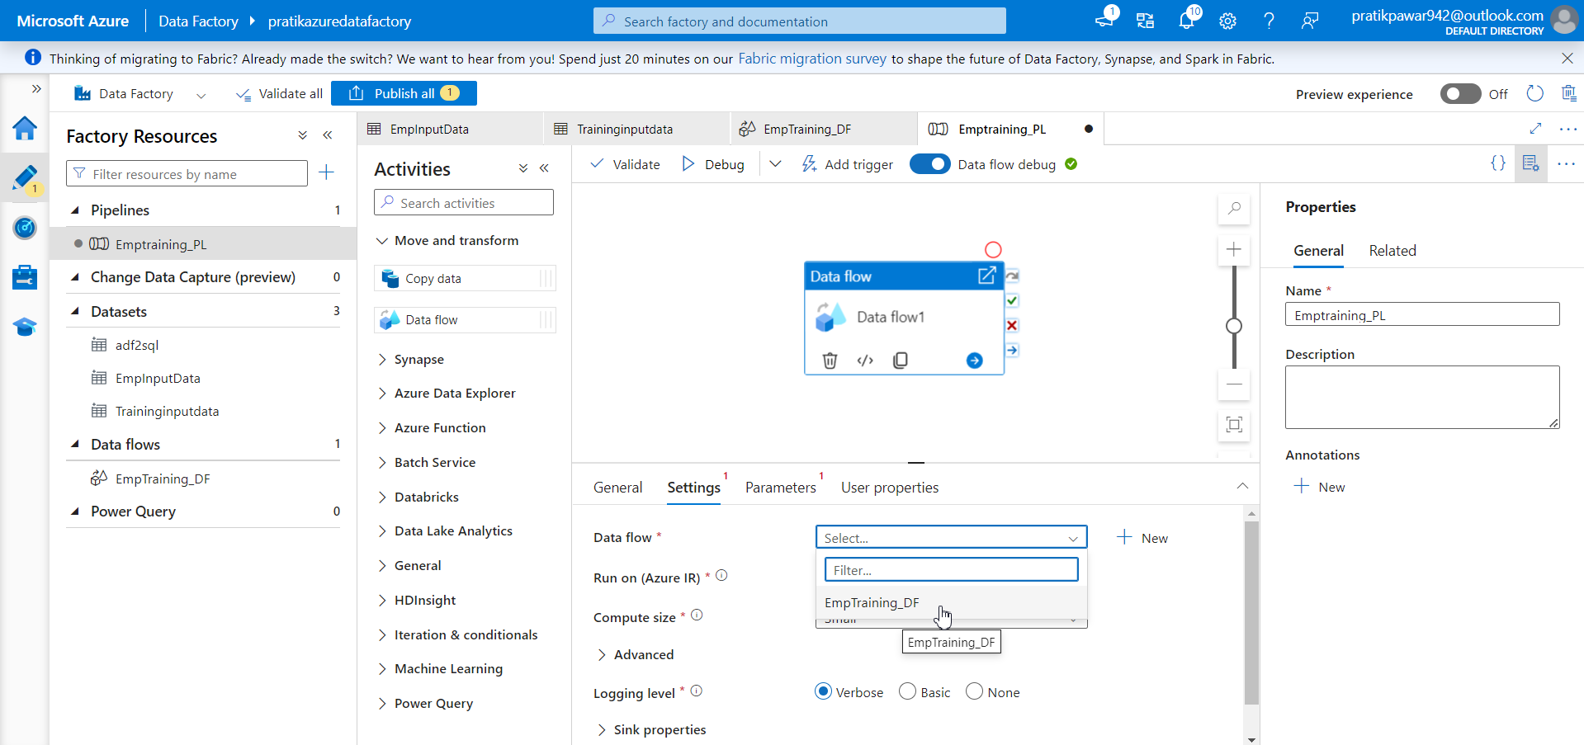
Go to settings → dataflow → EmpTraining_DF

Slide 31
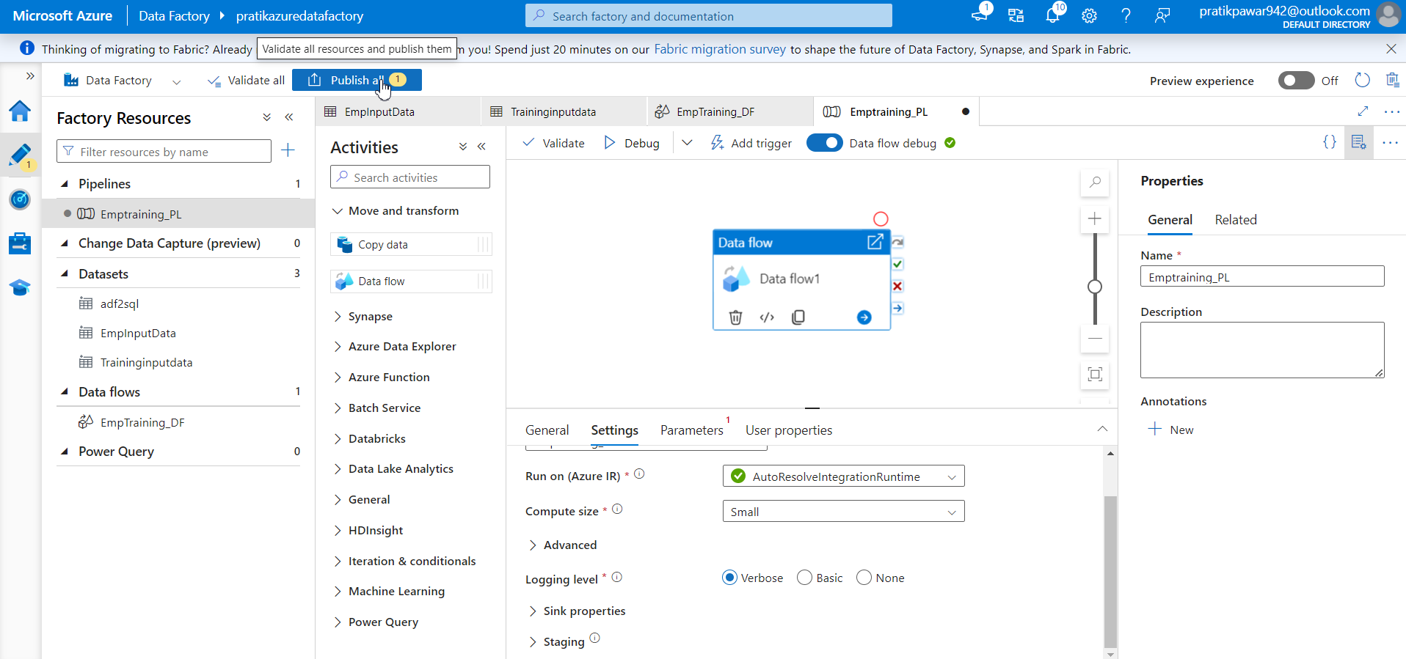
Publish

Slide 32
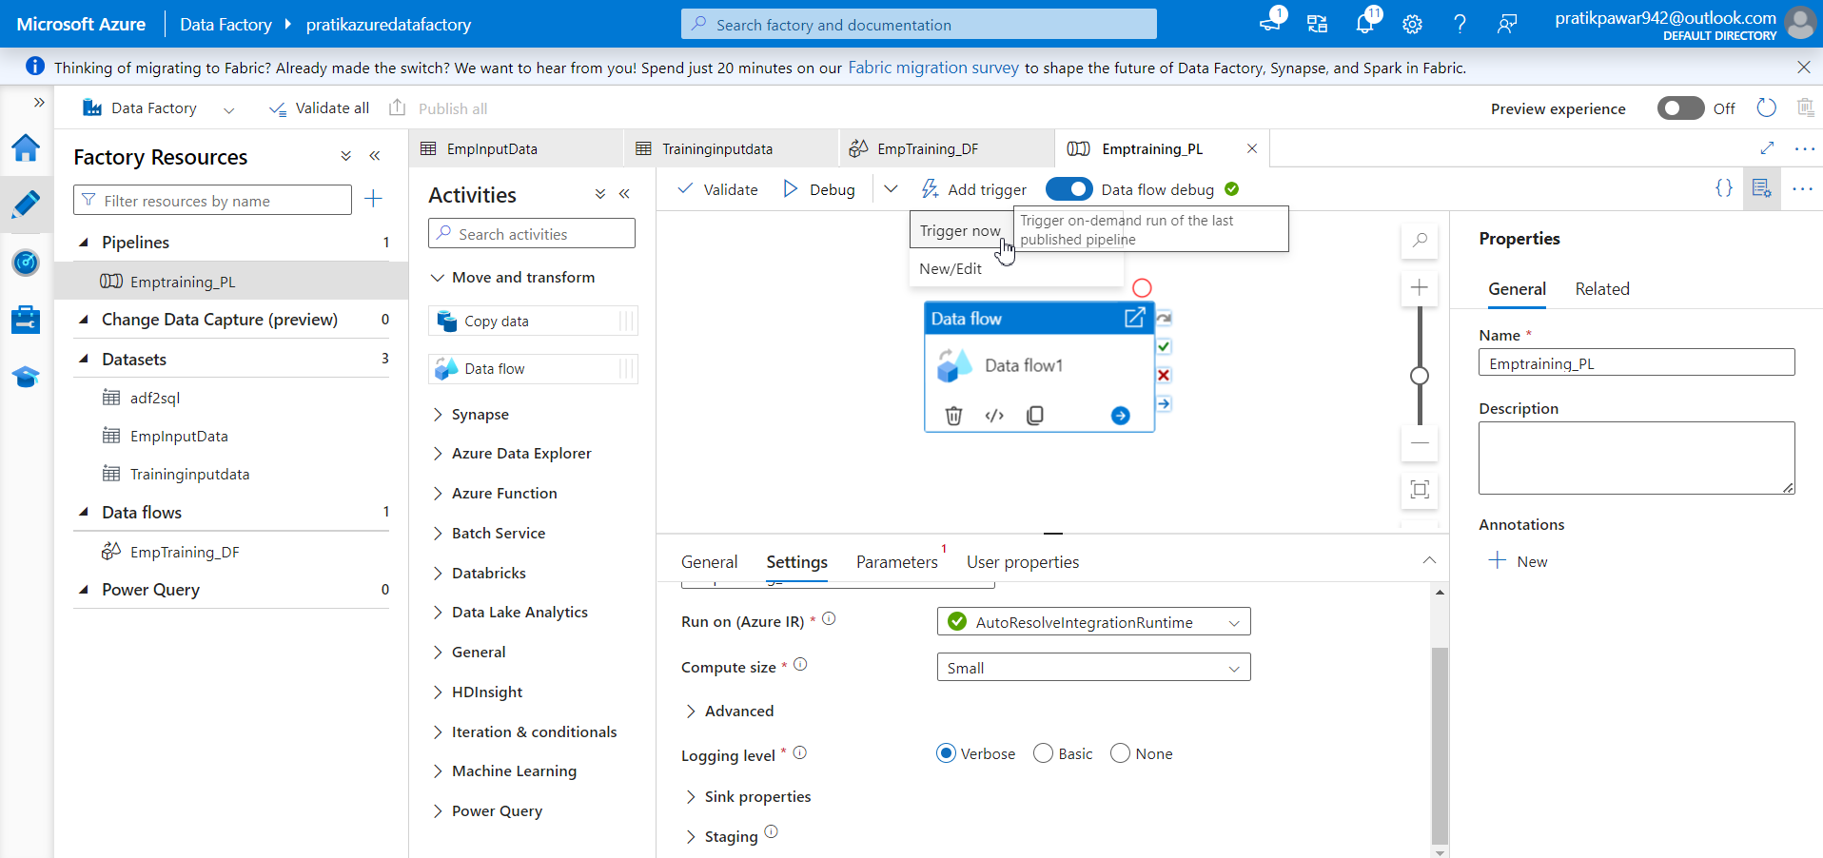
Trigger now

Slide 33
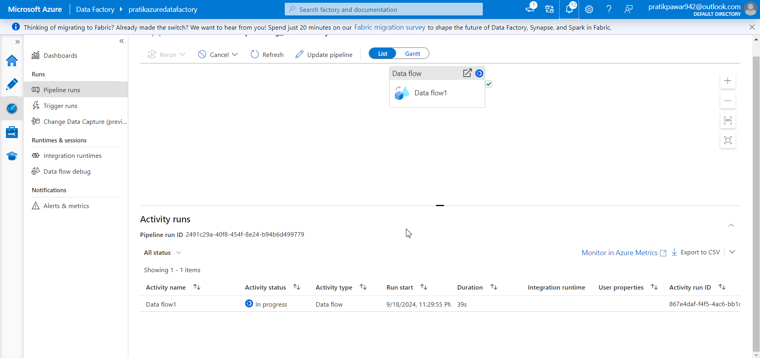
Wait for pipeline to complete

Slide 34
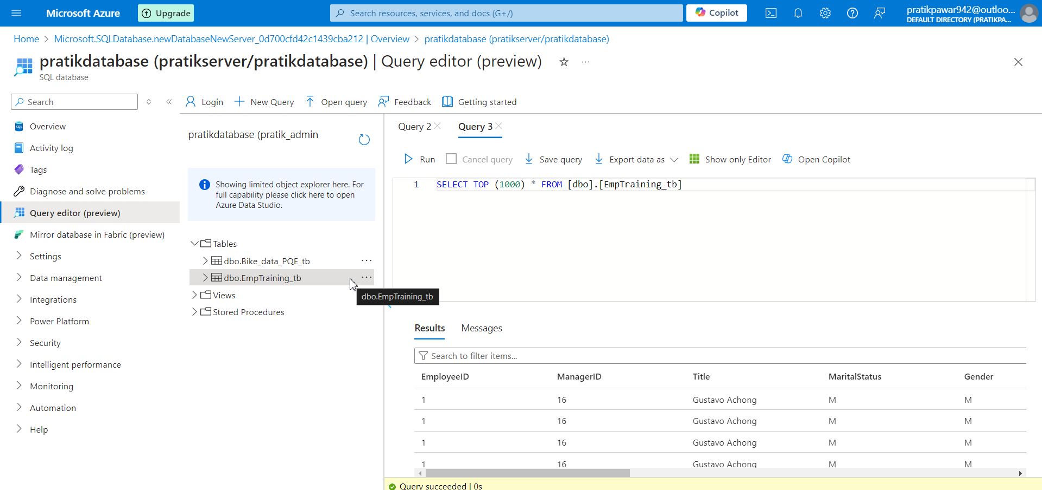
Data is transfer through pipeline in SQL database

